Slide 1



Welcome to Year 4

Slide 2
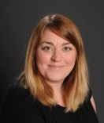
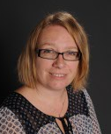
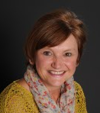
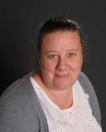
Staff in Year 4
Mrs Morton
Year 4 Teacher
Mon, Tue, Thurs, Fri
Mrs Webster
Deputy Head and SendCo
Wednesdays
Mrs Irving
LSA
Mrs Stanley
LSA
Tuesday Afternoon

Slide 3

Lighting the flame for lifelong learning
Our school mission is
‘Lighting the flame for lifelong learning.’
We want the children to feel curious, confident and proud.
In Year 4, we will help children enjoy learning, become more independent and develop their resilience when faced with challenges.

Slide 4
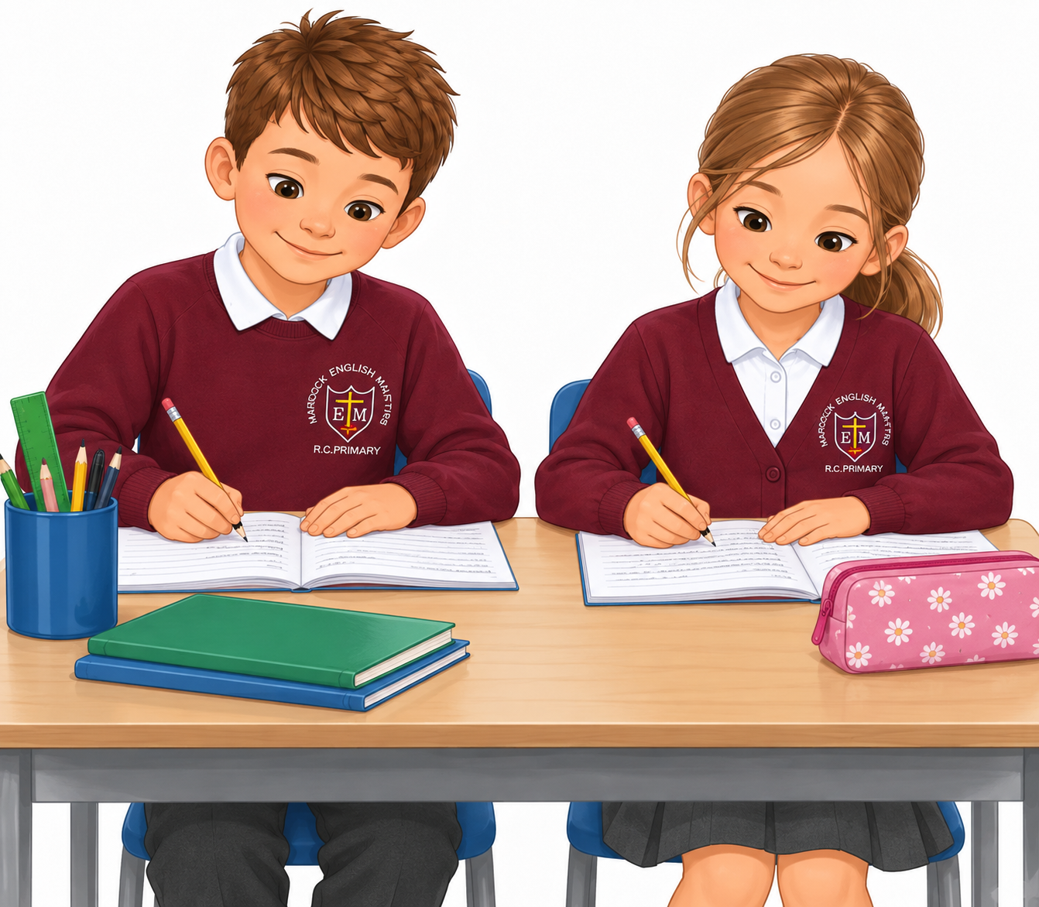
What Year 4 will feel like for the children
1
Year 4 is a time to grow in independence and take more responsibility. Year 4 are the oldest children in our building so are in a prime position to set a good example to the younger children.
We will practise resilience and keep going when learning feels tricky.
2
We will take pride in trying to produce our best work that is presented neatly. We will be conscious of the choices we make and really try to be kind to others as well as ourselves.
3
We will learn to work more independently as well as working in groups or pairs, making our own decisions.
4

Slide 5
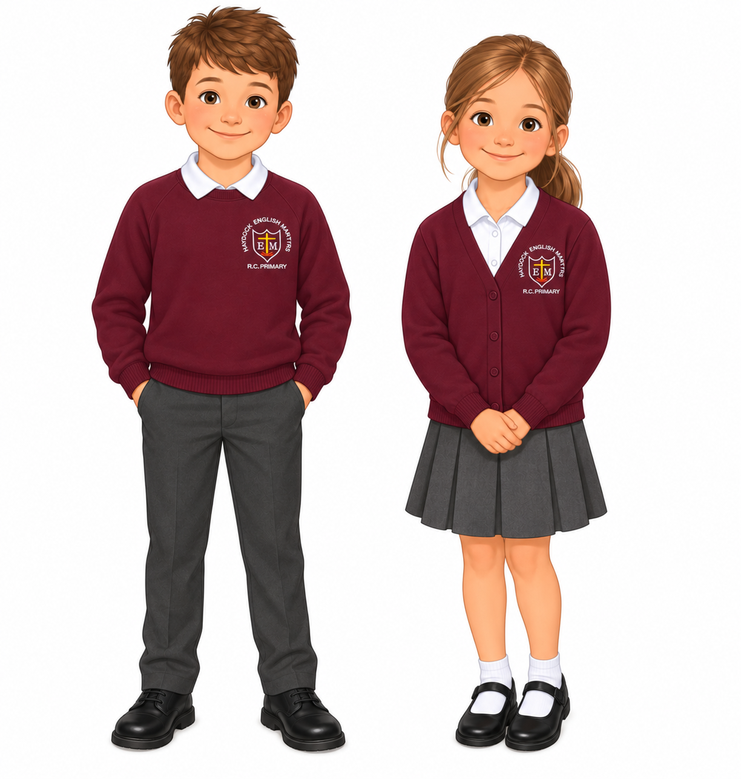
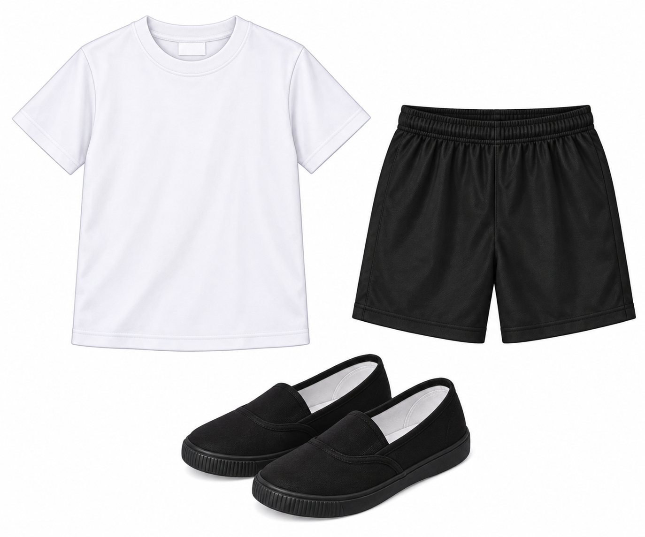

PE Day is TUESDAY come in PE Kit.
On colder days plain black joggers or leggings can be worn.
UNIFORM
No jewellery eg bracelets, necklaces etc
Plastic spacer earrings may be worn so that piercings don’t close up but only with flat backs.

Slide 6
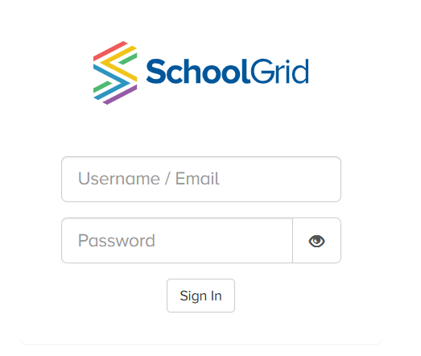
What to bring to school every day
Reading book in a book bag
Water Bottle –water only
Coat - certainly during the Autumn and the Spring Terms
Lunch – if on packed lunch
If your child is having a school lunch please remember to order on School Grid.

Slide 7
Our School Day
Gates Open | 8:40
School Starts | 8:50
Classroom door closes | 9:00
Break | 11:00 – 11:15
Lunch | 12:30 – 13:15
School Ends | 15:20
If you arrive later than 9am, please go to the office to sign your child in.

Slide 8
How to contact school
Absences & Medical Appointments
Absences from school must be reported to the school office on the first day of the absence (as early as possible) using the form on ParentApp or by calling 01942 723 552
Leave of Absence
The school will only grant a pupil a leave of absence in exceptional circumstances. In order to have requests for a leave of absence considered, the school will expect parents to contact the headteacher by completing a leave of absence form prior to the proposed start date of the leave of absence, providing the reason for the proposed absence and the dates during which the absence would be expected to occur.

Slide 9
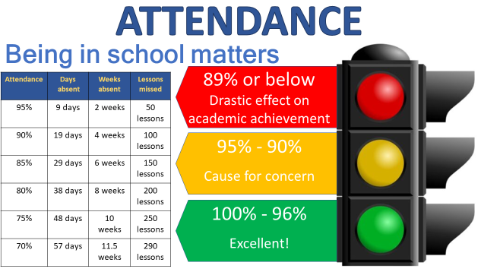
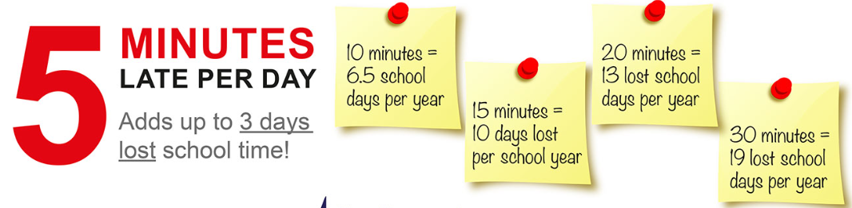
Our days are busy and start immediately at 8:50 with morning tasks, so it’s really important that the children are on time for school.

Slide 10
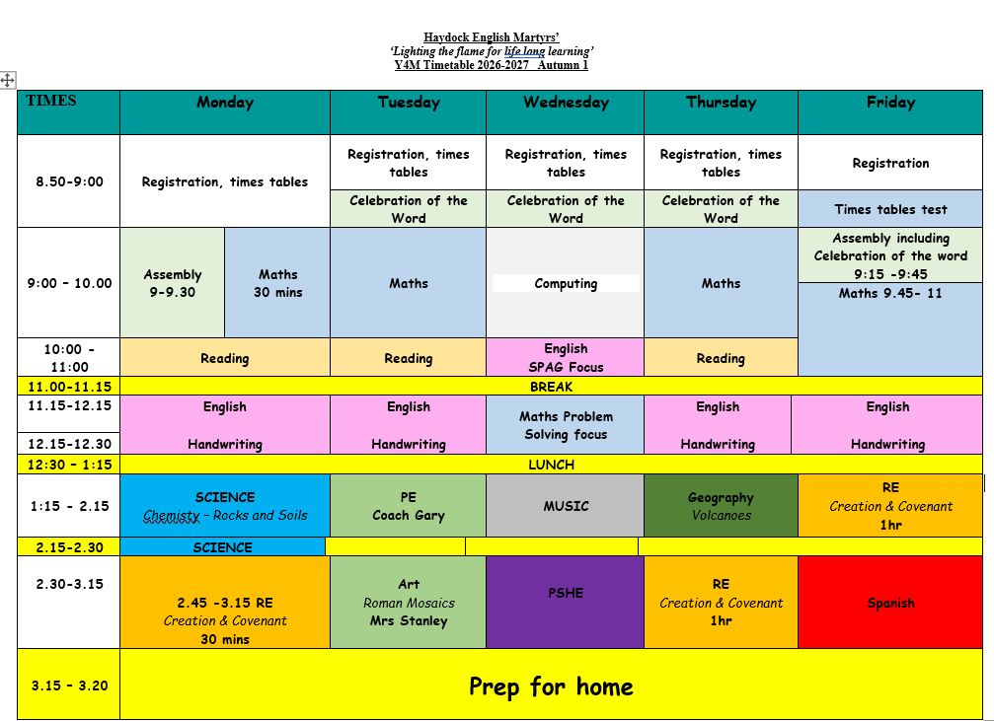

Slide 11





What we will learn this year – English and Reading
We will read often to help build fluency and develop vocabulary.
We will make links between the texts we read and our writing, by using many of the books we read as inspiration for writing.
For example, The Lion The Witch and The Wardrobe which we are reading now will inspire some fanstasy writing in the Spring Term. The Bog Baby will help us when we are writing persuasive letters and we will make links to our learning in History later in the year when reading There’s a Viking in My Bed and writing our own Viking Myths.

Slide 12
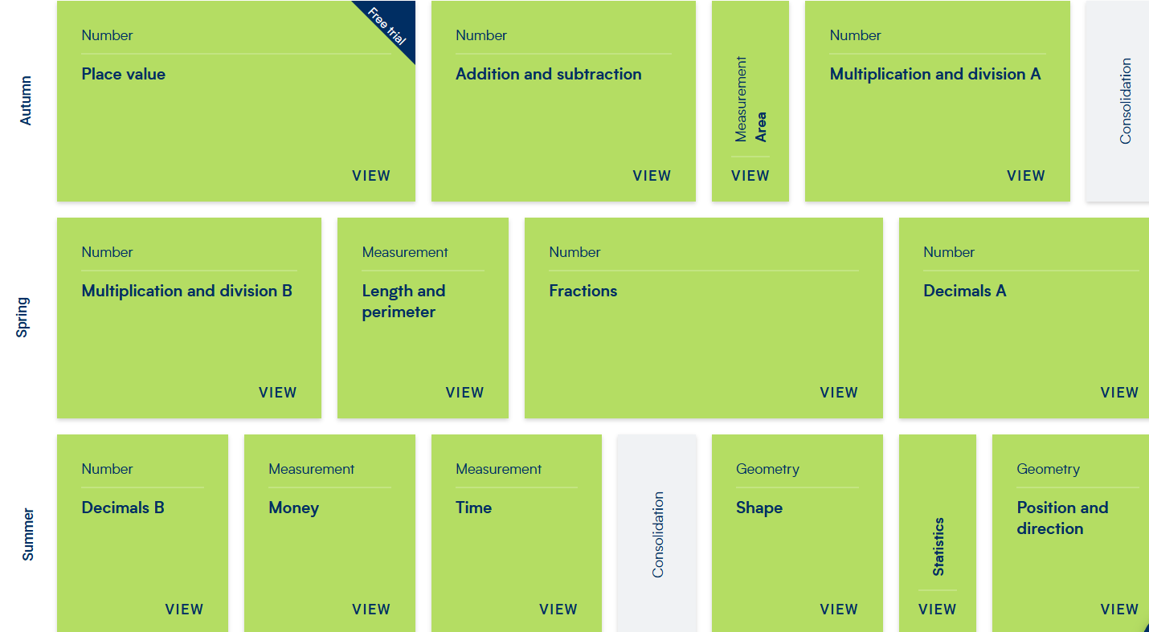
What we will learn this year – Maths

Slide 13
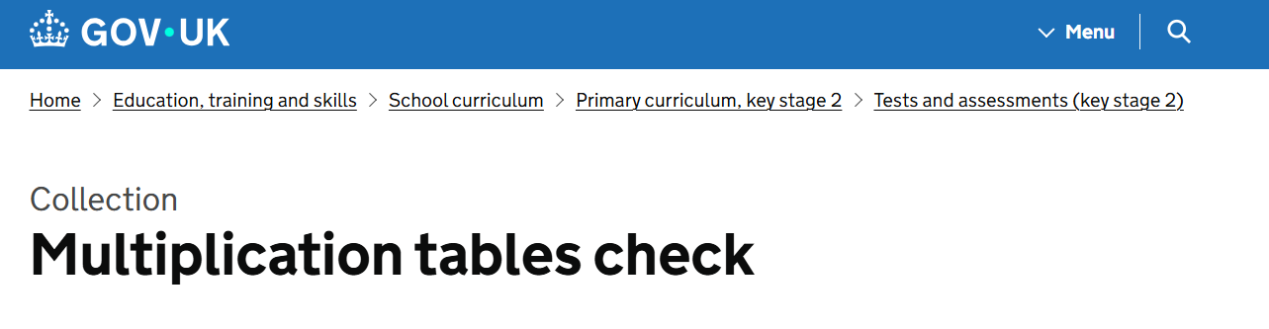

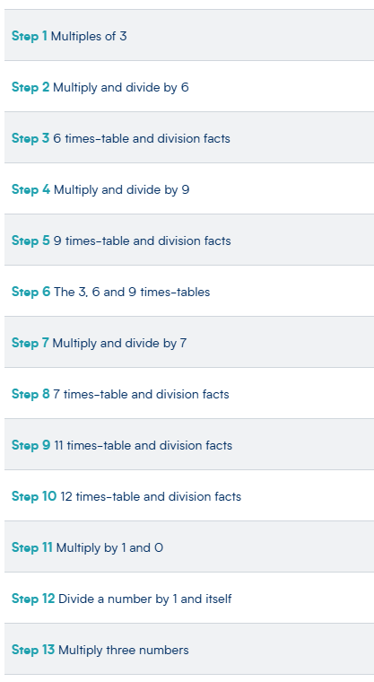
Times Tables
We start Year 4 with this unit which is all about times tables.

Slide 14
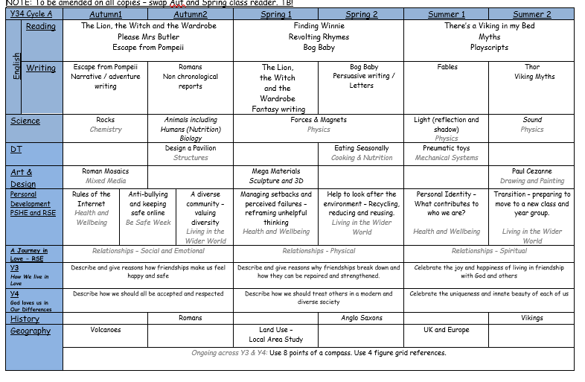
The Wider Curriculum

Slide 15
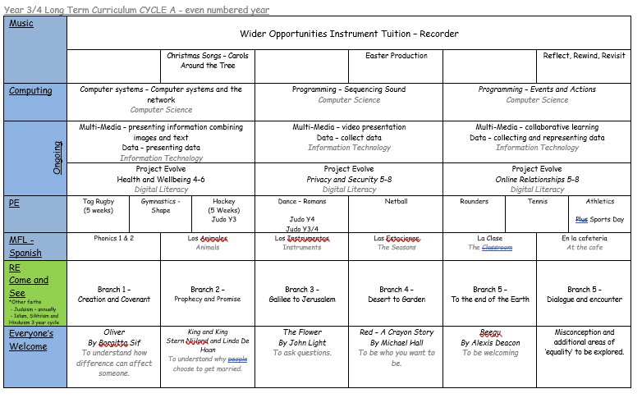

Slide 16

Homework
Reading – at least 3 times per week. Children earn their reading badges with their home reading.
Please sign the Reading Record.
75 – Bronze, 150 – Silver, 225 – Gold
Times Tables – Weekly Tasks will be set on TT Rockstars to be completed at home
Additional Tasks – if necessary will be sent home on a Wednesday to be returned on a Monday.

Slide 17
Water bottles come in and go home each night to be washed and
re-filled with plain water.
The children are asked to keep them on the sink to avoid spillages which result in damage to workbooks.
Break Time Snacks
We encourage the children to bring in healthy snacks for their break.
There is sometimes fruit available for KS2 but not always.
Healthy snack examples:
Fruit/raisins
Vegetable snacks
Breakfast bar
Toast/crumpet
Tube yogurts
Mini cheese
NO SWEETS, CHOCOLATE or CRISPS!

Slide 18
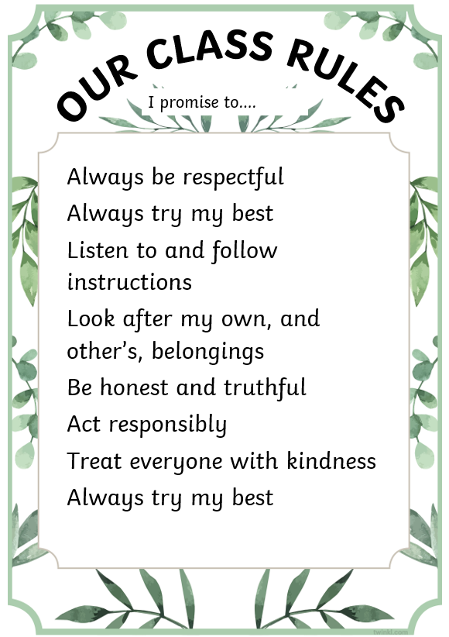
Behaviour and classroom expectations
Our classroom is calm, kind and safe. We use clear routines and high expectations so everyone can learn well. We notice effort, celebrate progress and help children make good choices.
The children have developed their own set of Rules to help everyone to be happy and feel safe in our class.
We encourage the children to go to the toilet as soon as they come into school, at break and at lunch in order to avoid ‘lost learning’.
It not only disturbs their own learning, but it disrupts other children when they are in and out to the bathroom during lessons.
Fidgets and comfort toys can have their place but aren’t always suitable or required by everyone during lessons. Please discourage your child from bringing them in unless previously discussed with the class teacher. If they are necessary then we can provide something in school.

Slide 19


Working together at school and at home
What we do at school
We teach new learning, build routines, give feedback and help children feel safe and ready to learn.
'
Notes:
We try to have very positive mindset. When the children say ‘I can’t do it’ we change that by adding the word ‘yet

Slide 20
Working together at school and at home
How you can help at home
Make sure your child attends regularly and is in school on time.
If you have any worries or concerns you can send a dojo message. I will check these before and after school.
If you need to get a message to me urgently then please contact the school office, or let me know at the door in the morning and I will arrange to call you or speak after school if possible
Encourage your child to read their book, do their TT Rockstars and complete any other homework that is given (remind them to bring it back to school!)

Slide 21
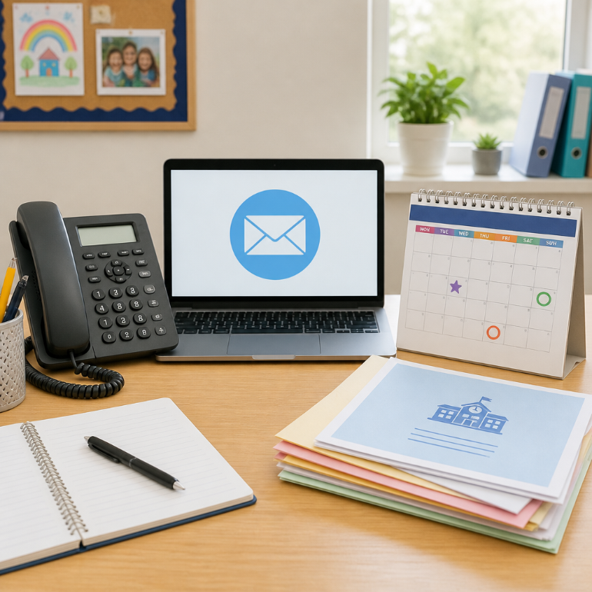
Make sure that you stay informed
Please check that the school office has your correct phone number
1
Look out for letters, emails and class updates during the year. On Parentapp and Classdojo.
2
Parents’ evenings and school events are important times to talk together.
3
Please check key reminders such as PE days, reading and homework.
4
If anyone would like to volunteer with school then please contact Mrs Bradshaw via Classdojo

Slide 22
Thank you
Thank you for coming and for supporting your child in Year 4.
We are looking forward to a happy, successful year together.

