Slide 1


Haydock English Martyrs
Catholic Primary School
Year 2W
2026-2027

Slide 2

School Mission Statement
Lighting the Flame for Lifelong Learning
We want the children to feel curious, confident and proud.
In Year 2, we will help children enjoy learning, become more independent and develop their resilience when faced with challenges.

Slide 3
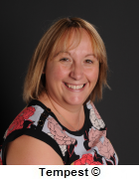
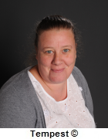
Staff In Year 2W
Mrs Wareing Mrs Stanley
Class Teacher LSA mornings
Teaches class on Wednesday
and Thursday afternoon.

Slide 4
Overview of School Day
Doors Open 8.50am
Doors Close 9.00am – if you arrive after 9am please go to
the school office.
Morning Playtime 10.40am – 11am
Lunchtime 12 noon – 1pm
Afternoon Playtime 2.00pm – 2.15pm
Home Time 3.20pm

Slide 5
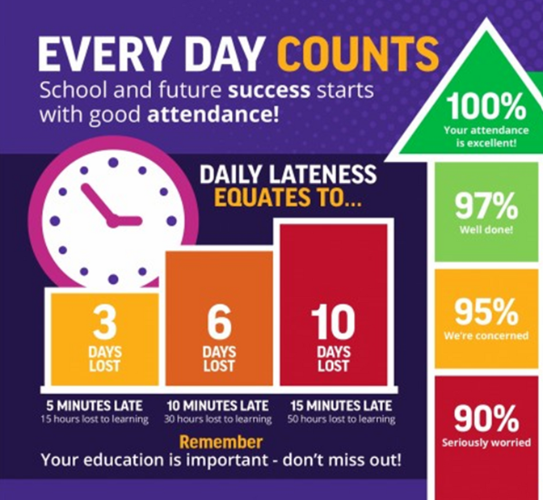
Attendance

Slide 6
What Year 2 will feel like for the children
Year 2 is a time to grow in independence. We will learn to work more independently as well as working in groups or pairs, making our own decisions.
We will practise resilience and keep going when learning feels tricky.
We will take pride in trying to produce our best work that is presented neatly.

Slide 7
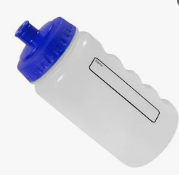
What to bring to school each day.
Reading book and Reading diary
Water bottle – filled with water and with a sports cap. This is kept in a water tray and can be accessed during the day.
PLEASE don’t send in pencil cases and precious items.

Slide 8
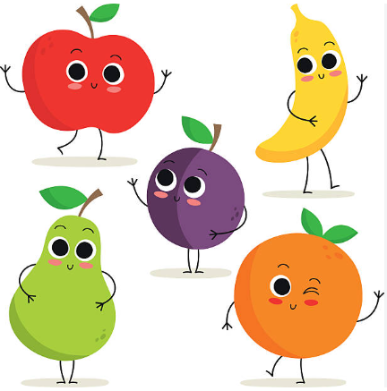

Lunch and Snack
A healthy snack is provided each day.
Please make sure you choose lunch for your child each week.
This is done via the School Grid website.

Slide 9
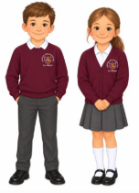
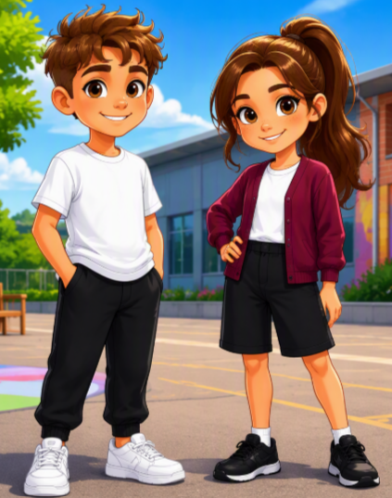
School Uniform
Please make sure that all items of clothing are clearly labelled with your child’s name.
Full uniform every day including black or brown shoes (not trainers)
PE kit worn on PE days (Thursday)
No earrings but the clear retainers are fine
Boys: white shirt or polo shirt; grey trousers or shorts; grey socks; maroon pullover and maroon/gold tie.
Girls: white blouse or polo shirt; grey or tartan skirt/pinafore or grey trousers; white socks; maroon cardigan and maroon/gold tie. During winter grey, black or navy tights may be worn.
In summer, girls wear a pink and white gingham dress and boys are allowed to attend in a short-sleeved shirt without the school tie or white polo shirt.

Slide 10
Homework
Every day – 10 minutes reading. Please write this in your child’s Reading diary each day so they earn their Reading Award Badges. Books are changed each Friday.
75 reads – Bronze 150 – Silver 225– Gold
Homework will set on a Wednesday and should be returned by the following Monday. This may also be an ICT based activity such as Numbots or Emilie.

Slide 11
Contacts
Absences MUST be recorded by telephoning the school office, 01942 723552 or Parent App.
Leave of absence
The school will only grant a pupil a leave of absence in exceptional circumstances. In order to have requests for a leave of absence considered, the school will expect parents to contact the headteacher by completing a leave of absence form, at least two weeks prior to the proposed start date of the leave of absence, providing the reason for the proposed absence and the dates during which the absence would be expected to occur.

Slide 12

Class Dojo
Class Dojo will be used to send messages. We will always try to contact you using the telephone for illness.
It is checked “at some point” in the day.
PLEASE DO NOT USE FOR URGENT MESSAGES AS IT MAY NOT BE LOOKED AT AFTER YOU SEND YOUR MESSAGE. PLEASE PHONE THE SCHOOL OFFICE.
Absence from school must ALWAYS be reported to the school office via Parent App or telephone call.

Slide 13
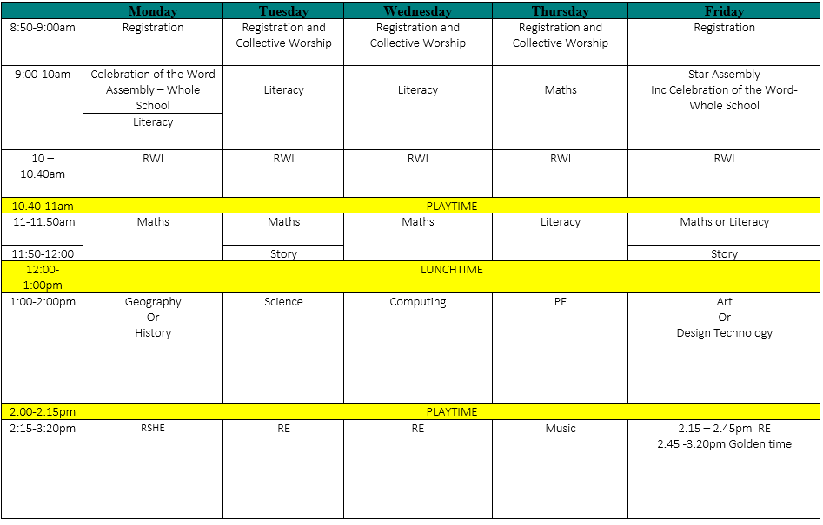
Class Timetable

